Slide 1
An introduction to global public investment
PRESENTED BY [NAME, ORGANIZATION] ON [DATE]

Slide 2
WHY IS GLOBAL PUBLIC INVESTMENT NEEDED?
Across the world we face enormous shared challenges – for people and planet. These include bio-diversity erosion, the threat of resurgent killer infectious diseases, the risk of major disasters, and the need for cheap renewable energy technology.
No country can face them alone, and no few countries should monopolize the response.
Global public investment is how such shared challenges can be overcome. Working together is the way we can tackle shared risks and maximize shared rewards.

Slide 3
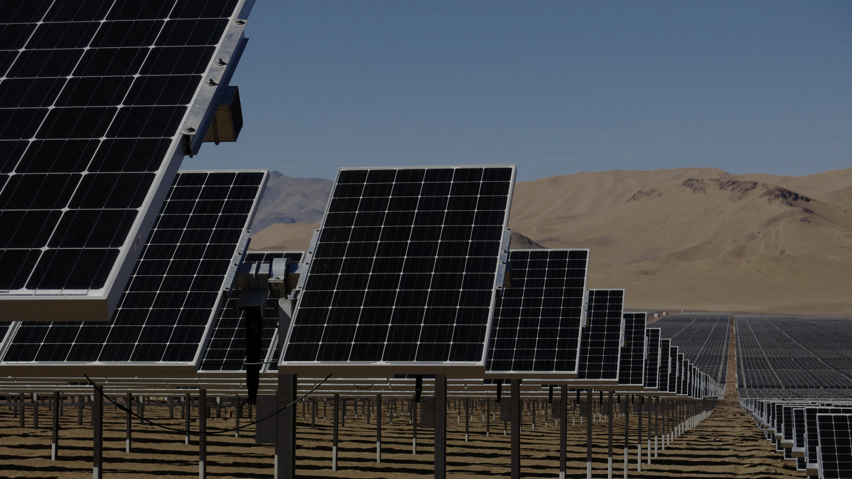
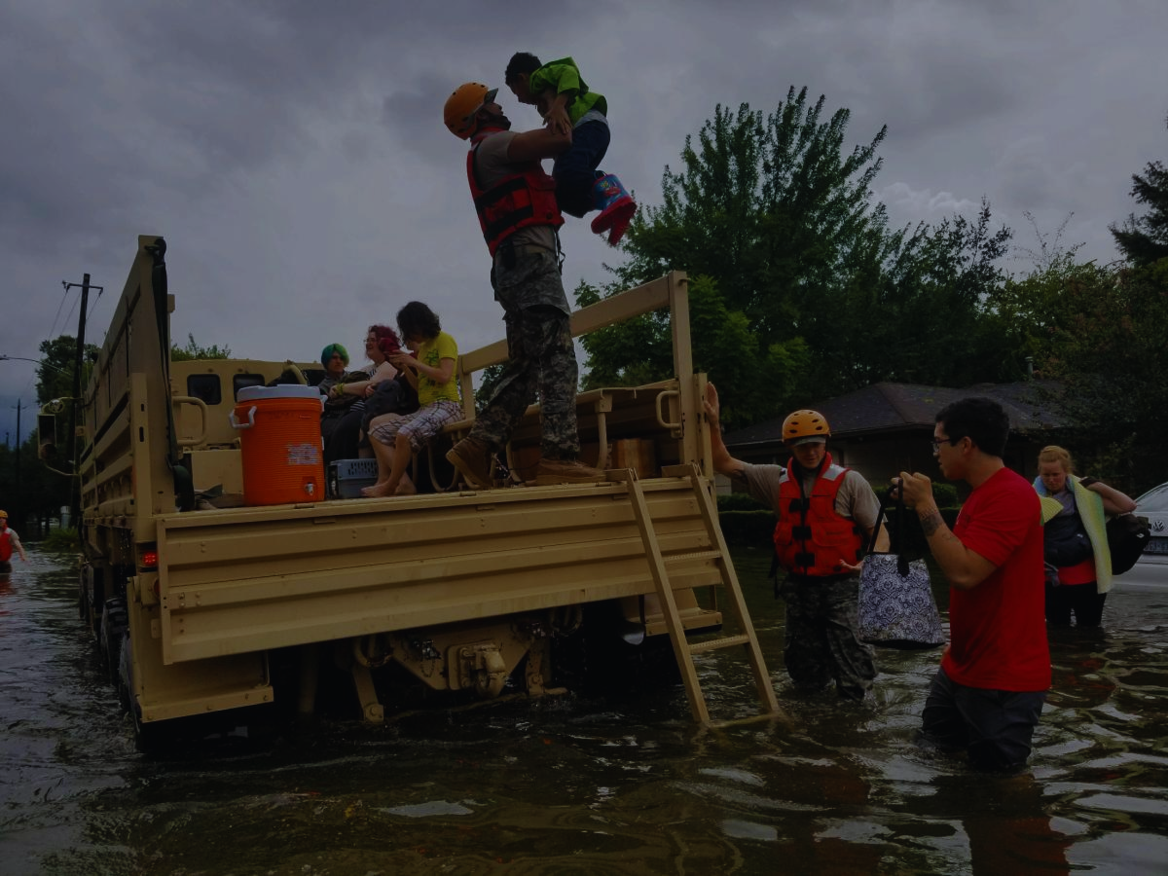
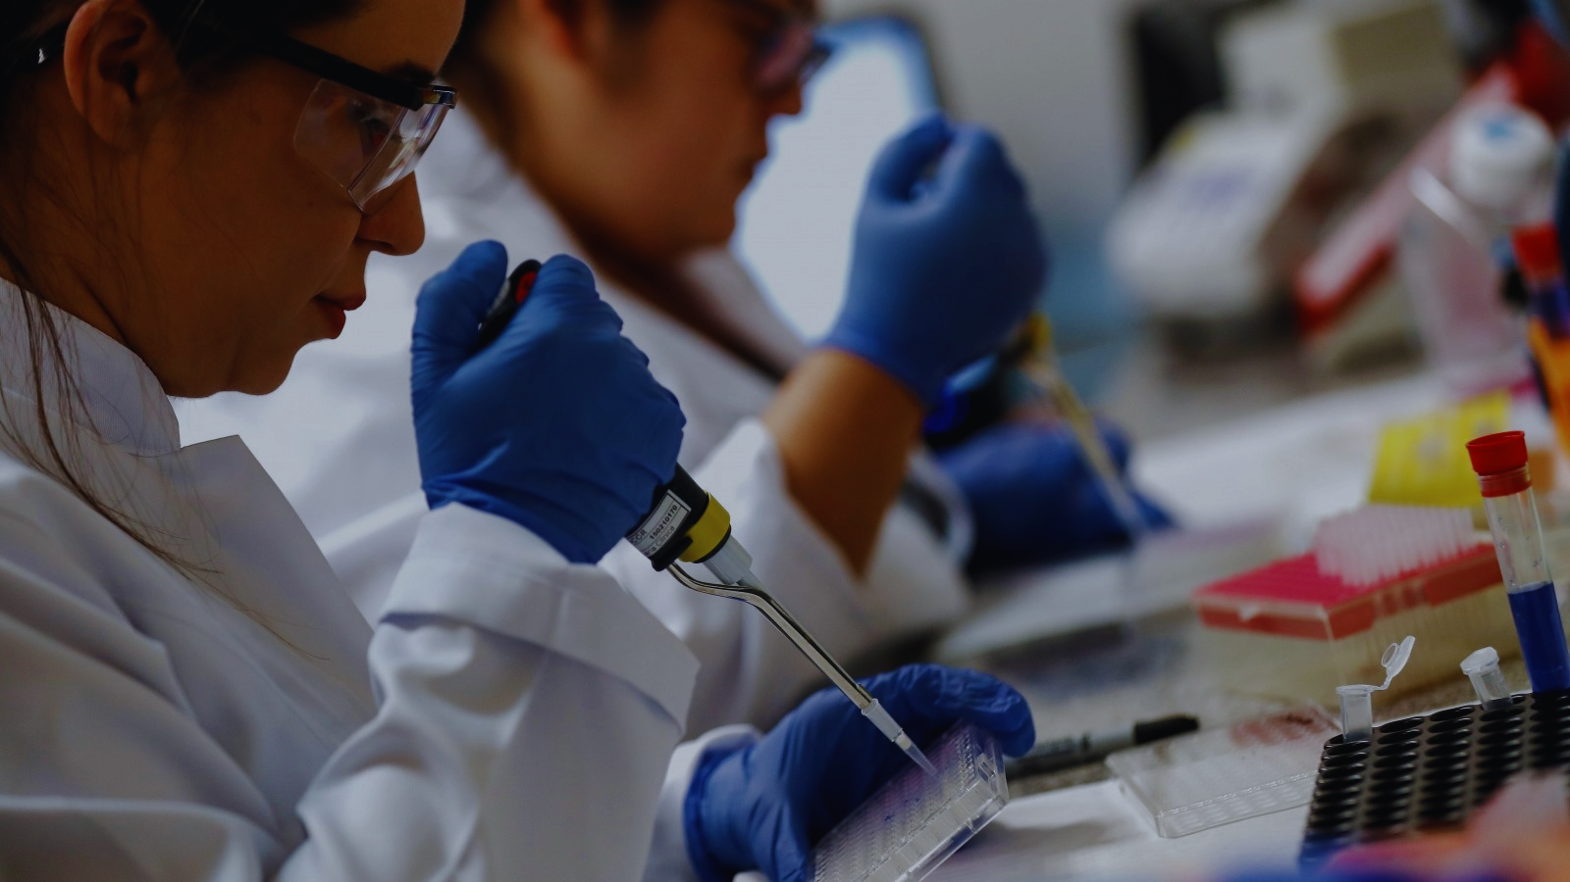
To enable a clean energy revolution
To ensure a rapid response when disasters strike
To beat pandemics
Global public investment

Slide 4
HOW DOES GLOBAL PUBLIC INVESTMENT WORK?
Global public investment works by pooling efforts: all benefit, all contribute, and all decide.
Everyone plays their part in meeting a common need from which everyone gains, and everyone steers those efforts together.
This is not charity—it is collective self-interest.
It is model fit for the twenty first century for financing global challenges

Slide 5





PRINCIPLES OF GLOBAL PUBLIC INVESTMENT
Universality: Every country involved
Equity: Contributions according to means
Democracy: Decisions made collectively
Effectiveness: Impact from pooling of resources and shared oversight
Sustainability: Long-term, predictable financing

Slide 6
CAN WE AFFORD THESE INVESTMENTS?
Collectively, yes we can. In fact, we can’t afford not to make them. These investments will ultimately save money.
Countries are already putting resources into crisis preparedness and response, research for medicines, and renewable energy technology, but too often, they operate in isolation or even competition with one another. With global challenges, cooperation is always a more effective strategy.
Of course, not all countries would pay the same amount. Just as within a country we all contribute through taxes to shared services from which we all benefit, international contributions would be scaled to each country’s means.
From this pooling of resources, everyone wins out.

Slide 7
CAN WE BUILD GLOBAL PUBLIC INVESTMENT
IN THIS TIME OF CRISIS?
Yes. Times of crisis are when new systems are built.
To succeed, new systems will need to include all countries as contributors and decision-makers.
Global public investment meets this moment.

Slide 8
MOMENTUM IS BUILDING FOR GLOBAL PUBLIC INVESTMENT
South Africa’s leadership of the G20’s Development Working Group has declared global public investment its “number one priority”.
Norway’s Norad agency has said “Global public investment is the closest thing to a shared vision for the transformation of international development.”
Over seventy globally diverse civil society organisations are backing the call for global public investment, including the International Treatment Preparedness Coalition, Southern Voice, Civicus, and Global Citizen.

Slide 9
CALL TO ACTION
Speak out in support of global public investment.
Help secure support from representatives of more countries.
Support international efforts, like those of the South Africa at the G20, to advance the development of global public investment.

Slide 10
FIND OUT MORE
Visit https://globalpublicinvestment.net to access a compendium of research on global public investment, find the latest news, and connect with allies at in-person and virtual events.

Slide 11
We can overcome our shared challenges - together
[NAME, ORGANIZATION]

